Slide 1
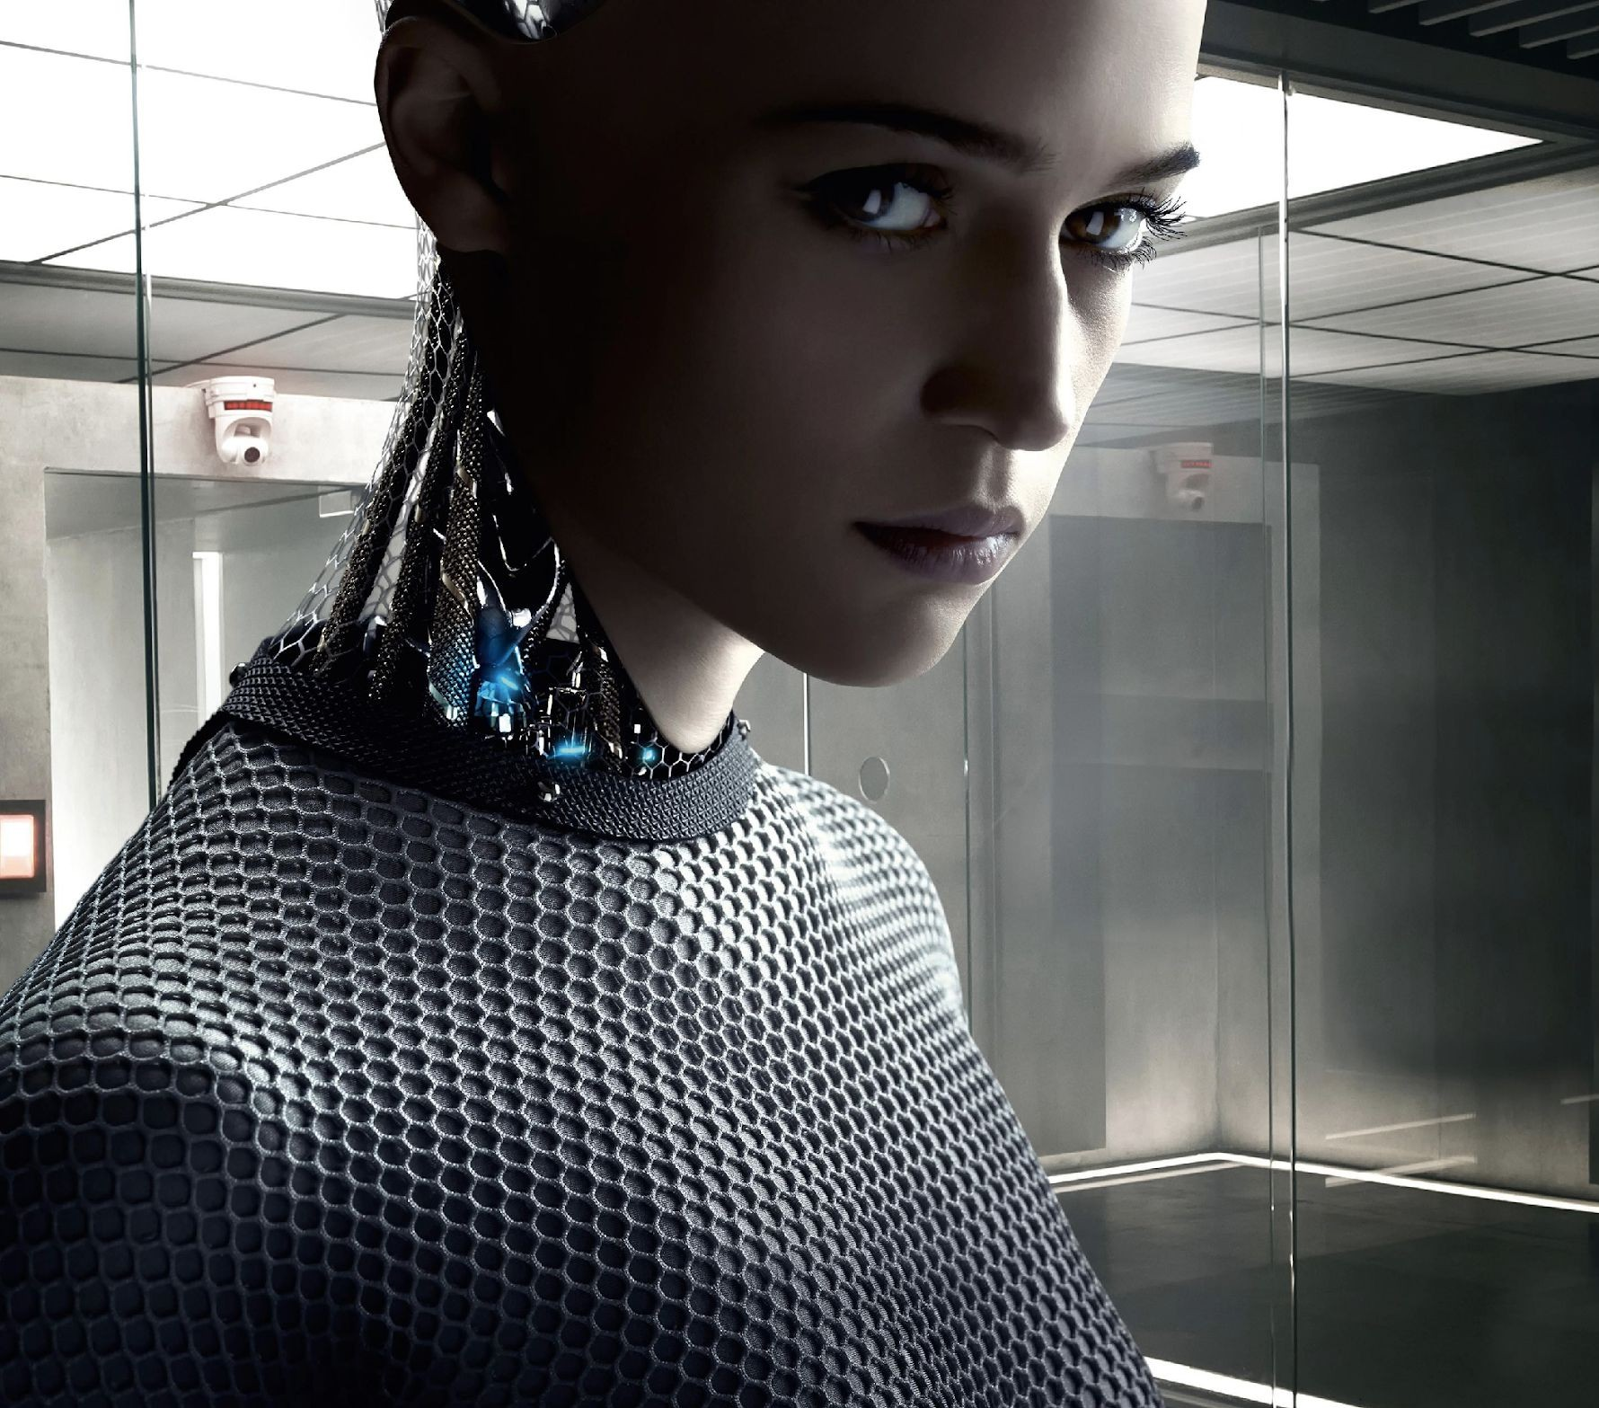

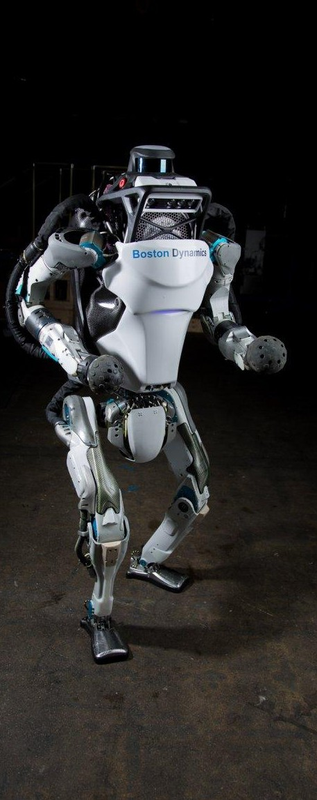
Introduction to Machine Learning

Slide 2
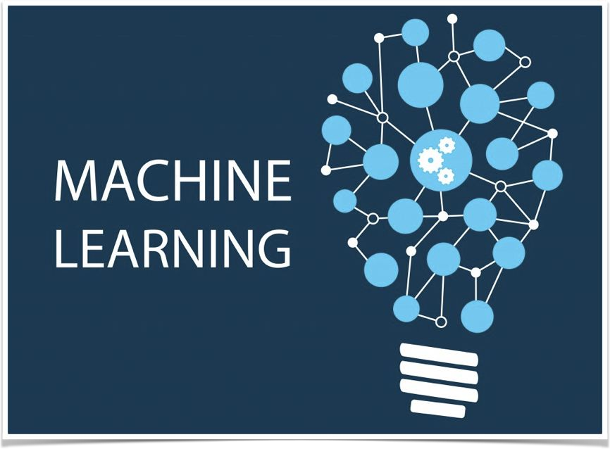
What Is Machine Learning?
Field of study that gives "computers the ability to learn without being explicitly programmed"
-- Arthur Samuel, 1959

Slide 3
What Is Machine Learning?
Let us understand it with real use case...

Slide 4
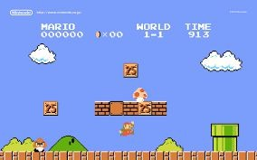
Have You Played Mario?
How much time did it take you to learn & win the princess?

Slide 5
Have You Played Mario?
Did Anyone teach you?

Slide 6
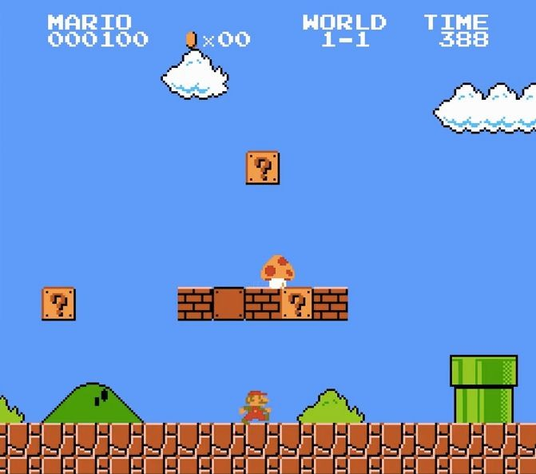
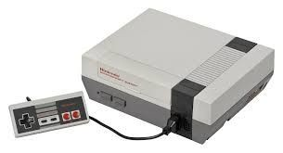
How About Automating it?

Slide 7
How About Automating it?
Program Learns to Play Mario

Slide 8
How About Automating it?
Program Learns to Play Mario
Observes the game & pressed keys

Slide 9
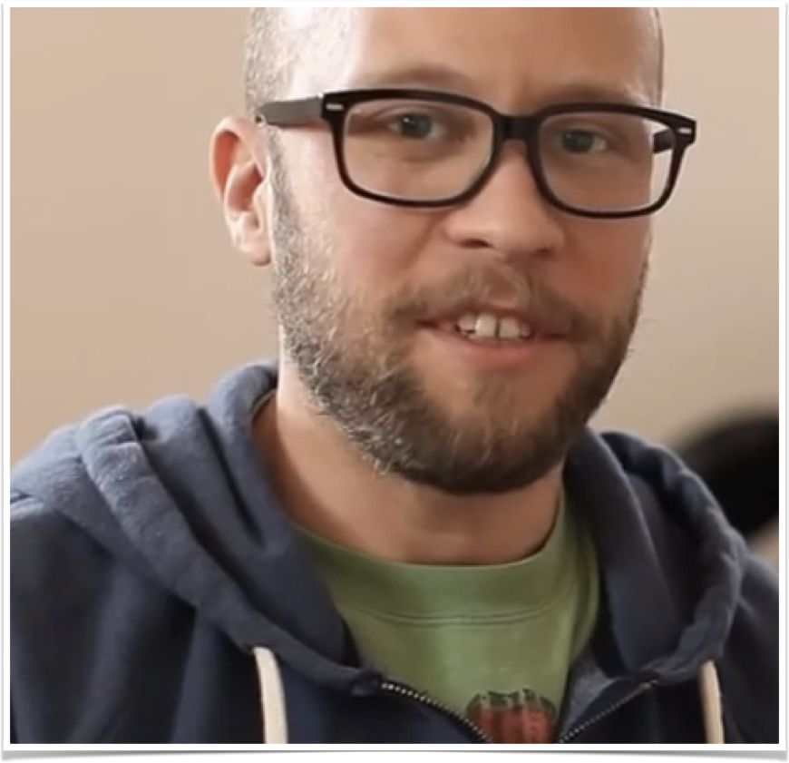
How About Automating it?
Program Learns to Play Mario
Observes the game & pressed keys
Maximises Score

Slide 10

How About Automating it?

Slide 11
How About Automating it?
So, the program learnt to play
Mario
And Other games
Without any programming

Slide 12
Question
To make this program learn any other games such as PacMan we will have to
Write new rules as per the game
Just hook it to new game and let it play for a while

Slide 13

Question
To make this program learn any other games such as PacMan we will have to
Write new rules as per the game
Just hook it to new game and let it play for a while

Slide 14
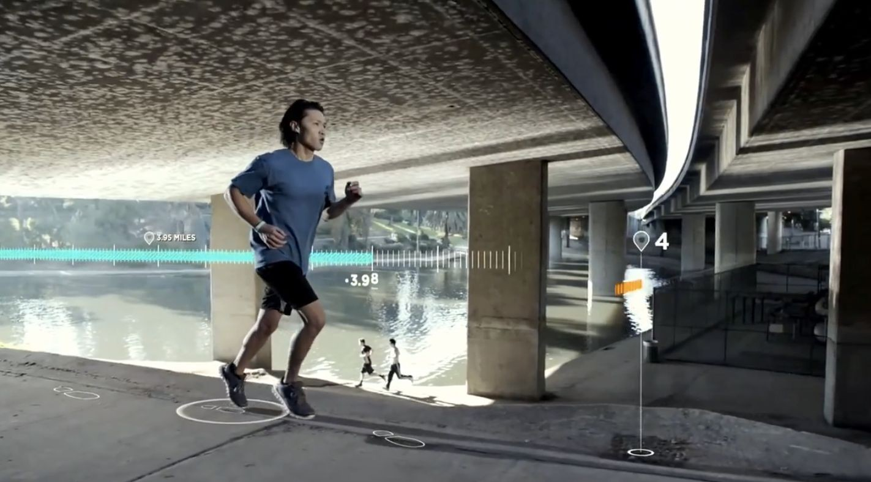
Imagine Doing The Same For Life
Gather data and automatically solve problems

Slide 15
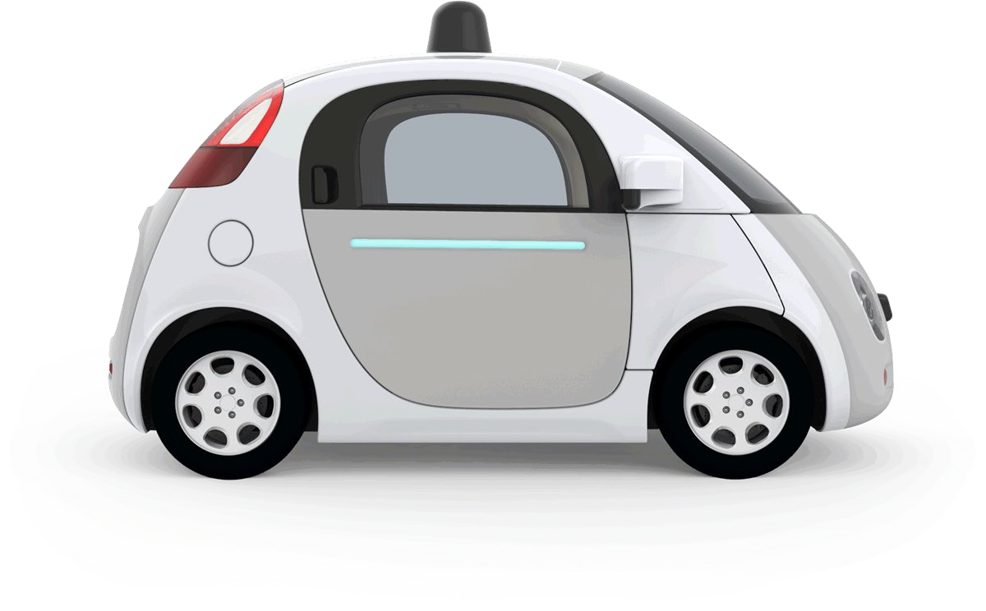
The Machine Learning Tsunami - 1
Self driving cars on the roads

Slide 16
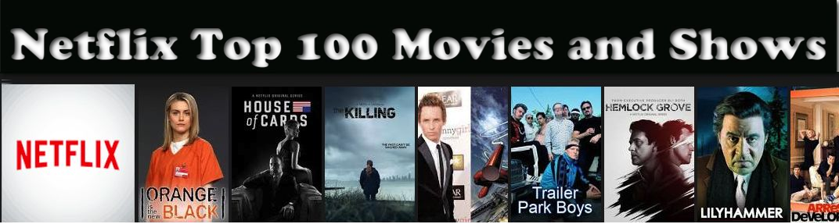
The Machine Learning Tsunami - 2
Netflix movies recommendations

Slide 17
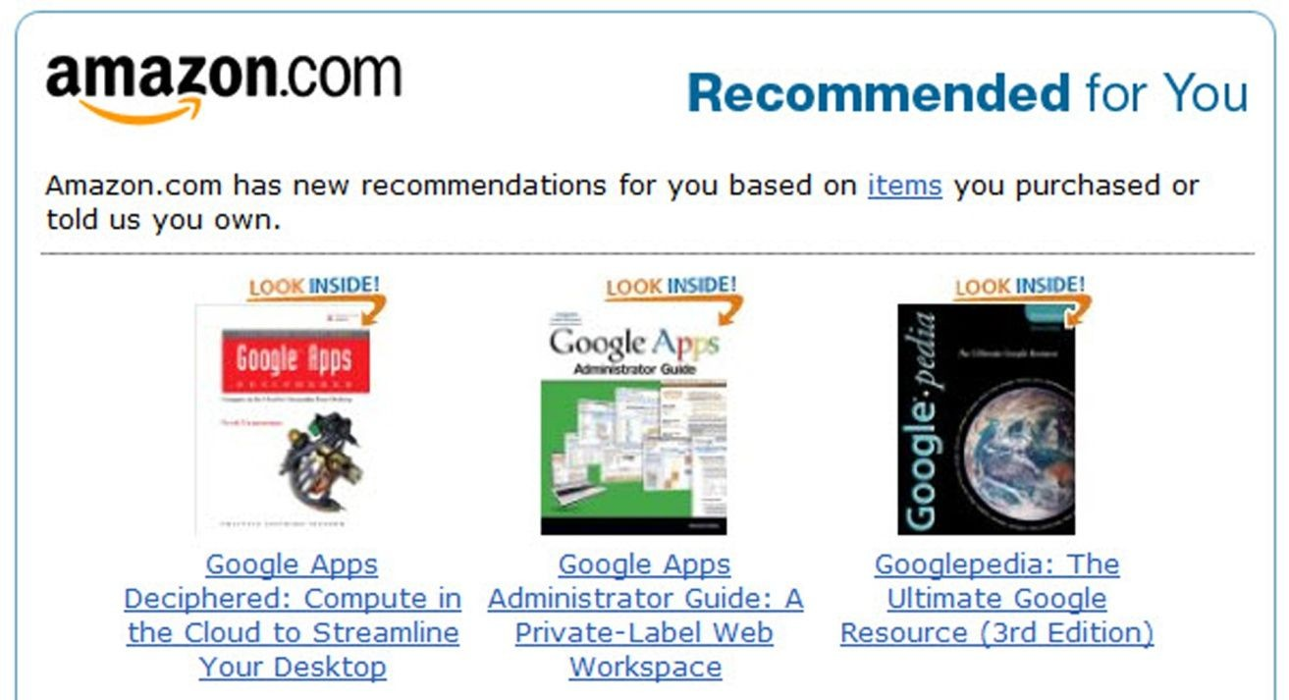
The Machine Learning Tsunami - 3
Amazon product recommendations

Slide 18
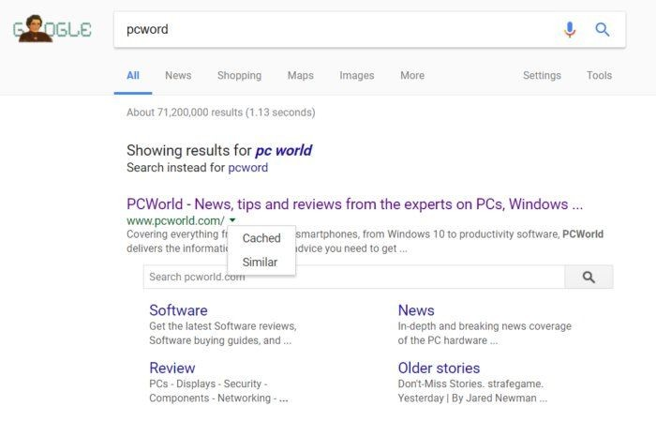
The Machine Learning Tsunami - 4
Accurate results in Google Search

Slide 19
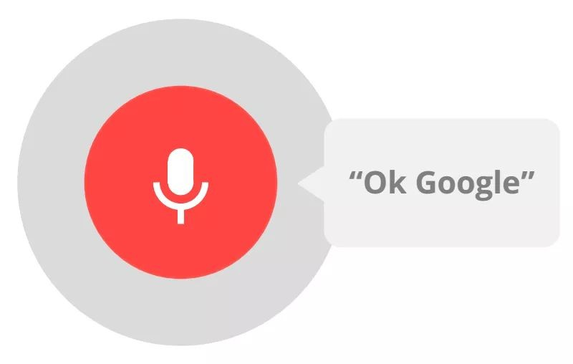
The Machine Learning Tsunami - 5
Speech recognition in your smartphone

Slide 20

Question
What do we need to
Gather Data
And automatically solving the problem?
₊Intelligence
Data

Slide 21

Gather Data
Collect
Cleaning
Process

Slide 22
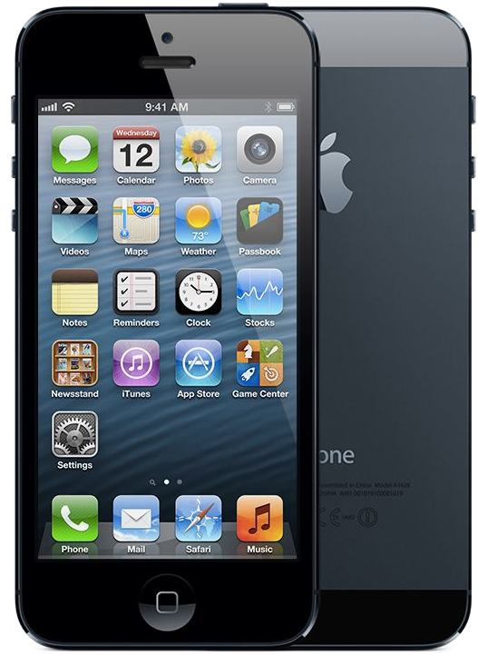


Collect Data - IOT
Phone & Devices
Cheaper, faster and smaller
Connectivity
Wifi, 4G, NFC, GPS

Slide 23

Process Data - Parallel Computing
Distributed
Groups of networked computers
Interact with each other
To achieve a common goal

Slide 24




Process Data - Parallel Computing
Multi Core + GPGPU (General Purpose Graphics Processing Units)
Processor
Processor
Processor
Many processors or Cores
Perform tasks and interact using
Memory or bus
Memory

Slide 25


Process Data - Parallel Computing
 | MULTI CORE | GPGPU | DISTRIBUTED
CAN HANDLE HUGE DATA? (DISK READ INTENSIVE)
REALLY FAST COMMUNICATION BETWEEN CPUS
GREAT FOR MATHS/GRAPHICS?
TOOLS | Hadoop MR, Apache Spark | Keras, TensorFlow, Caffe, Spark (Exp) | Hadoop MR, Apache Spark

Slide 26


Intelligence - Traditional vs ML.
How you would write a spam filter?

Slide 27
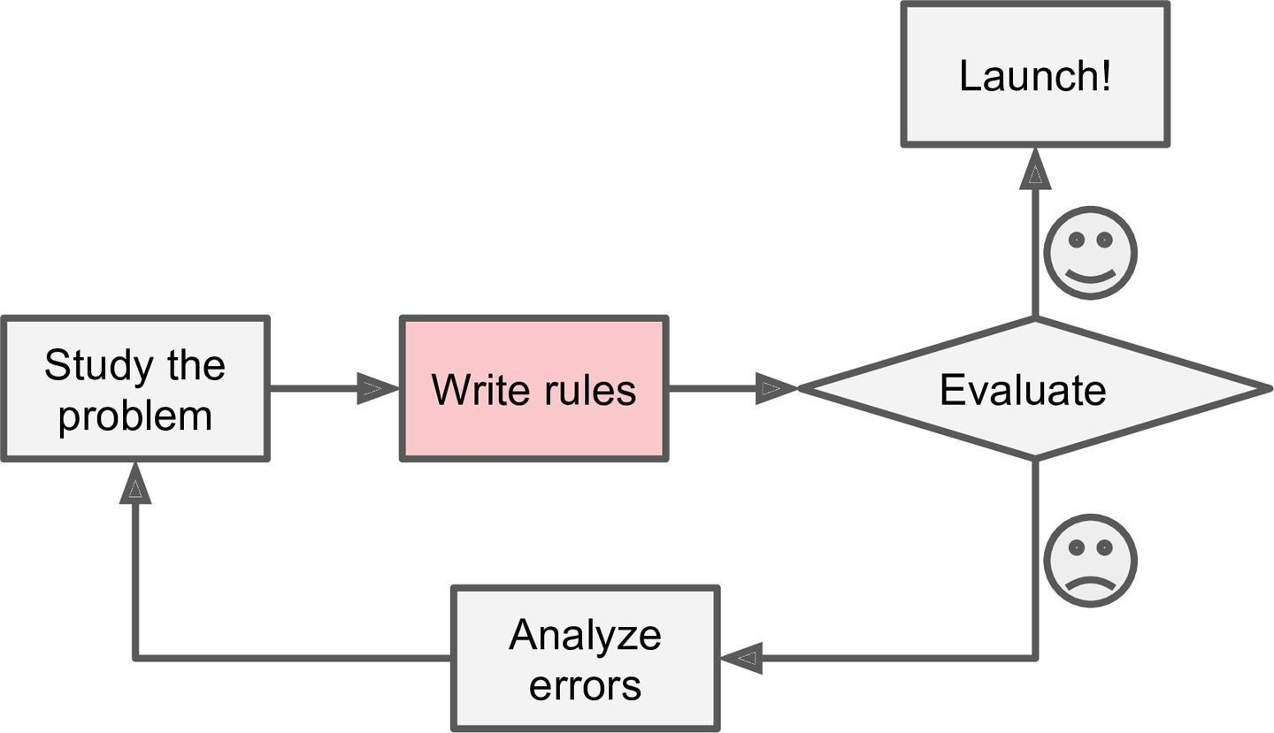
Intelligence - Spam Filter - Traditional Approach
1
2
3

Slide 28
Intelligence - Spam Filter - Traditional Approach
Problems?

Slide 29
Intelligence - Spam Filter - Traditional Approach
Problems?
Problem is not trivial
Program will likely become a long list of complex rules
Pretty hard to maintain
If spammers notice that
All their emails containing “4U” are blocked
They might start writing “For U” instead
If spammers keep working around spam filter, we will need to keep writing new rules forever

Slide 30
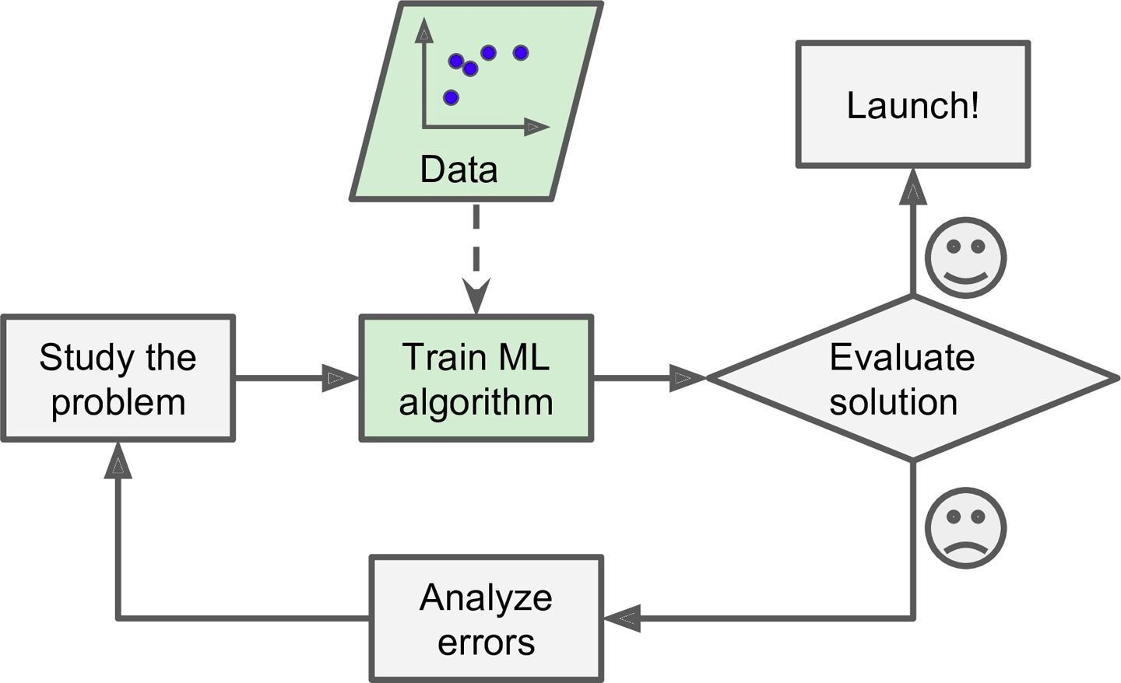
Intelligence - Spam Filter - ML Approach

Slide 31
Intelligence - Spam Filter - ML Approach
A spam filter based on Machine Learning techniques automatically learns
Which words and phrases are good predictors of spam
By detecting unusually frequent patterns of words
The program will be
Much shorter
Easier to maintain
Most likely more accurate than traditional approach

Slide 32
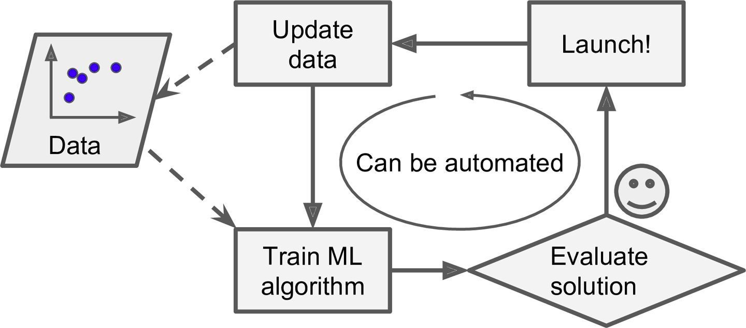
Intelligence - Spam Filter - ML Approach
Unlike traditional approach, ML techniques automatically notice that
“For U” has become unusually frequent in spam flagged by users and
It starts flagging them without our intervention

Slide 33
Intelligence - Spam Filter - ML Approach
Can help humans learn
ML algorithms can be inspected to see what they have learned
Spam filter after enough training
Reveals combinations of words that it believes are best predictors of spam
May reveal unsuspected correlations or new trend and
Lead to a better understanding of the problem for humans

Slide 34
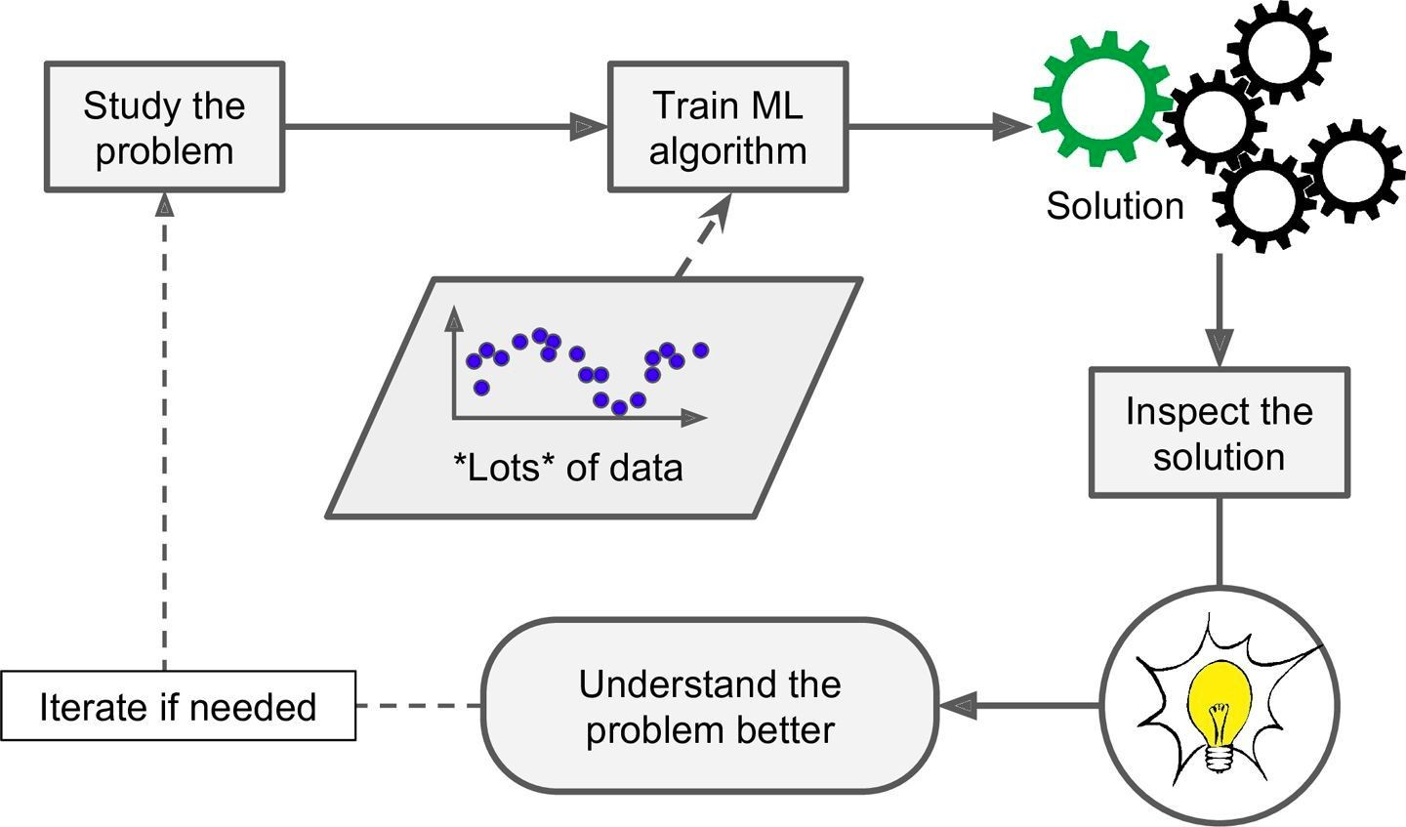
Intelligence - Spam Filter - ML Approach
Can help humans learn

Slide 35
What is AI?
Artificial intelligence (AI):
The intelligence exhibited by machines

Slide 36
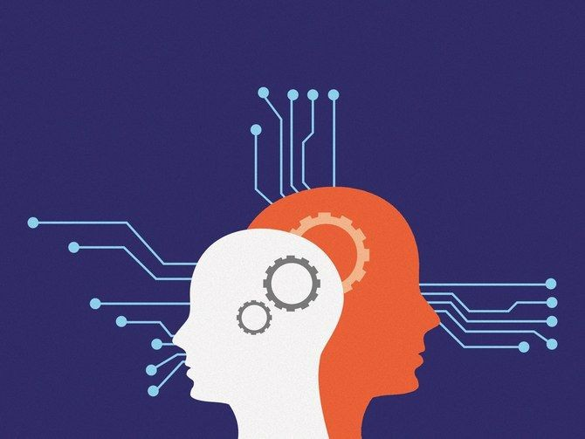
What is AI?
The theory and development of computer systems

Slide 37
What is AI?
The theory and development of computer systems
To perform tasks requiring human intelligence such as

Slide 38

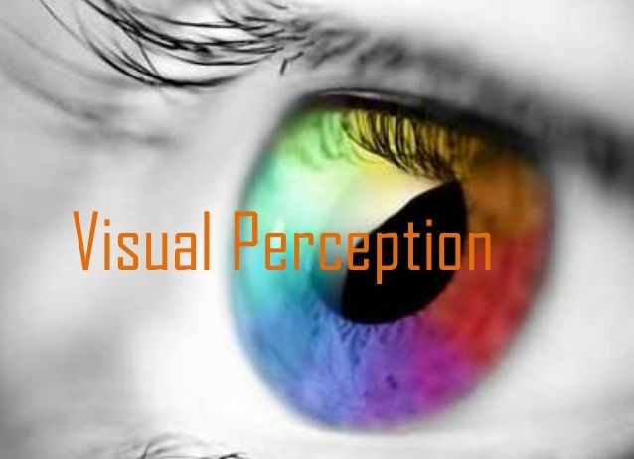
What is AI?
The theory and development of computer systems
To perform tasks requiring human intelligence such as
Visual perception

Slide 39
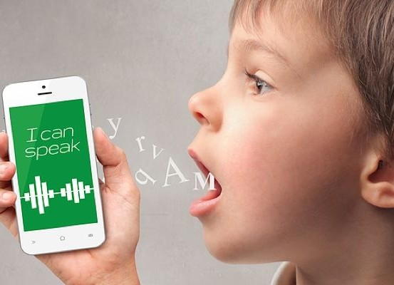
What is AI?
The theory and development of computer systems
To perform tasks requiring human intelligence such as
Visual perception
Speech Recognition

Slide 40

What is AI?
The theory and development of computer systems
To perform tasks requiring human intelligence such as
Visual perception
Speech Recognition
Decision Making

Slide 41

What is AI?
The theory and development of computer systems
To perform tasks requiring human intelligence such as
Visual perception
Speech Recognition
Decision Making
Translation between languages

Slide 42
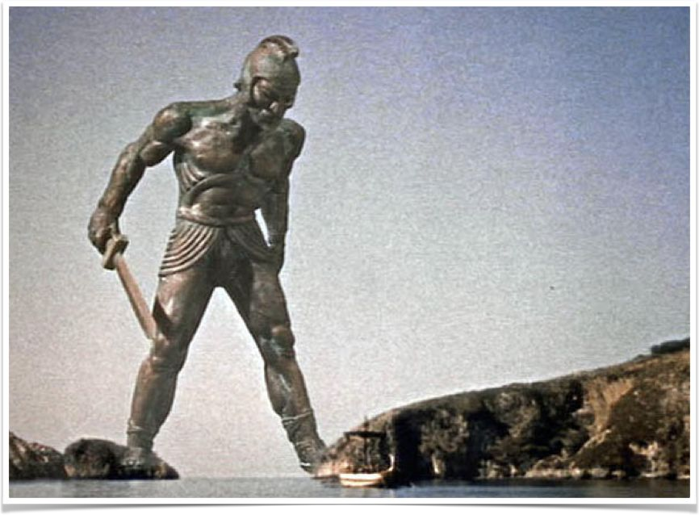
History - Mythology / Fiction
In every mythology, there is some form of mechanical man such talos from greek mythology.
In fiction novels, we have Mary Shelley’s Frankenstein
We are fascinated by the idea of creating things which can behave like human

Slide 43
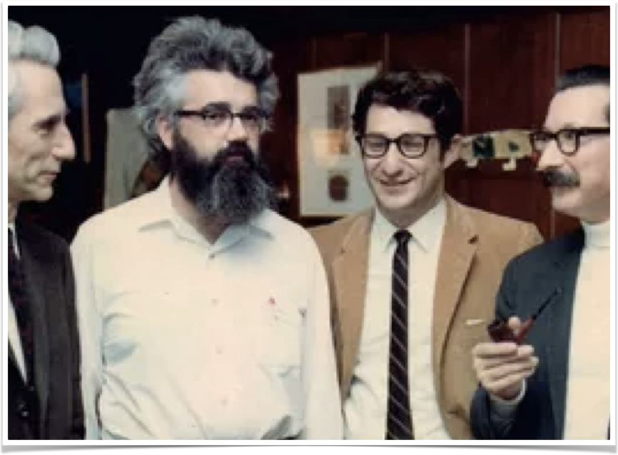
History - Summer of 1956
The term artificial intelligence was coined by
John McCarthy
In a workshop at
Dartmouth College in New Hampshire
Along with Marvin Minsky, Claude Shannon, and Nathaniel Rochester

Slide 44






Sub-objectives of AI
Perception
Reasoning
Artificial Intelligence
Represent Knowledge
Navigate
Natural language processing

Slide 45
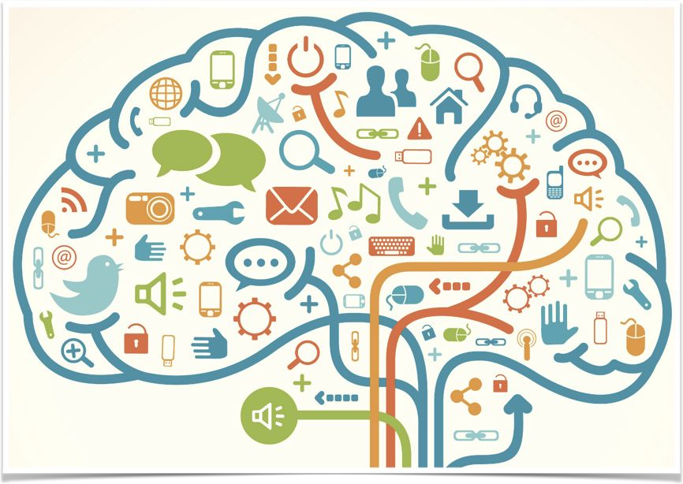
AI - Represent Knowledge
Understanding and classifying terms or things in world e.g.
What is computer?
What is a thought?
What is a tool?
Languages like lisp were created for the same purpose

Slide 46
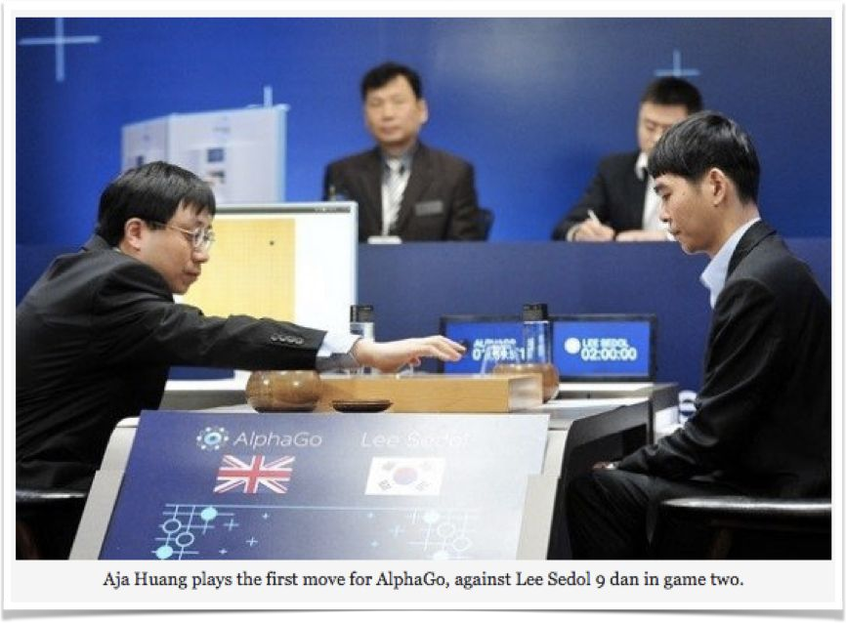
AI - Reasoning
Play puzzle game - Chess, Go, Mario
Prove Geometry theorems
Diagnose diseases

Slide 47
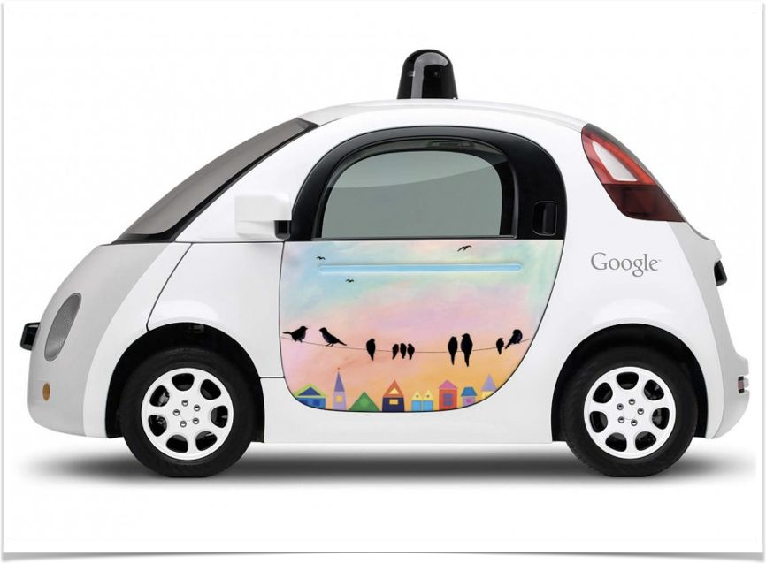
AI - Navigate
How to plan and navigate in the real world
How to locate the destination?
How to pick path?
How to pick short path?
How to avoid obstacles?
How to move?

Slide 48
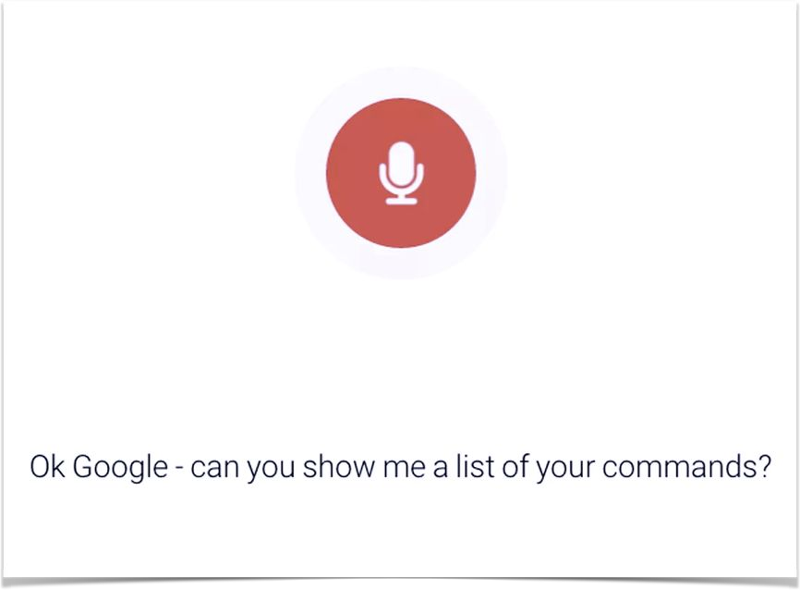
AI - Natural Language Processing
How to speak a language
How to understand a language
How to make sense out of a sentence

Slide 49
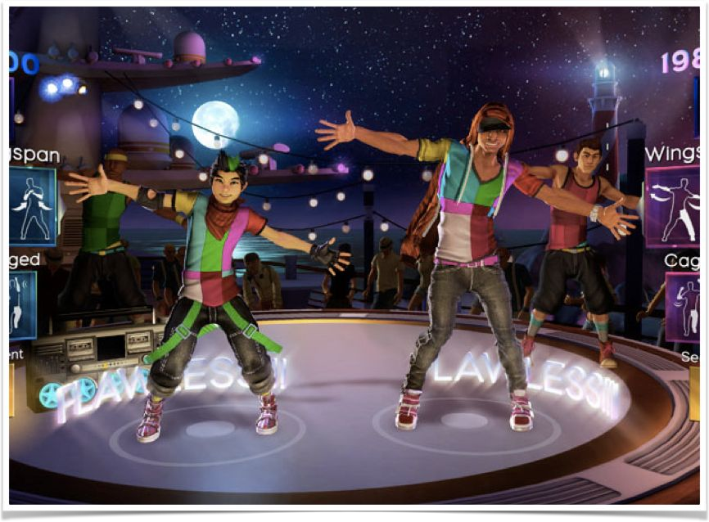
AI - Perception
How to we see things in the real world
From sound, sight, touch, smell

Slide 50
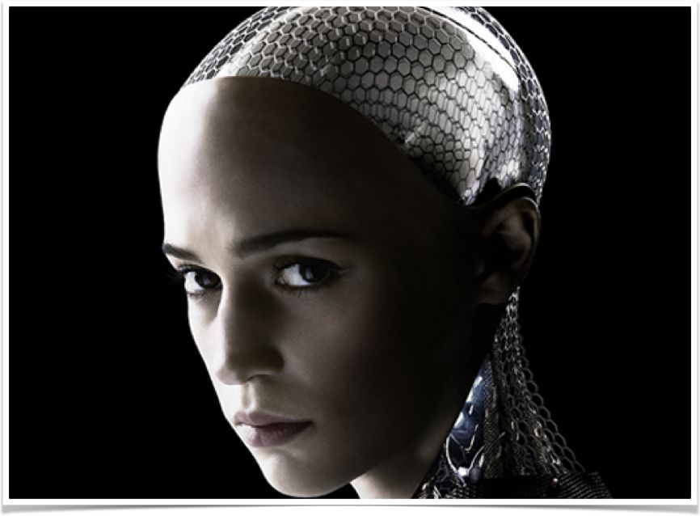
AI - Generalised Intelligence
With these previous building blocks, the
following should emerge:
Emotional Intelligence
Creativity
Reasoning
Intuition

Slide 51











AI - How to Achieve
Robotics
Domain Specific Computing
Artificial Intelligence
Rule Based Systems Expert System
Machine Learning
Deep Learning

Slide 52

Machine Learning - Types
Human Supervision?
Machine Learning
Learn Incrementally?
How they generalize?

Slide 53
Machine Learning - Types
Human Supervision?
Machine Learning
Learn Incrementally?
How they generalize?

Slide 54




Machine Learning - Types
Supervised
Human Supervision?
Unsupervised
Reinforcement
Machine Learning
Learn Incrementally?
How they generalize?

Slide 55
Machine Learning - Supervised Learning
Whether or not models are trained with human supervision

Slide 56


Machine Learning - Types
Supervised
Classification
Regression
Human Supervision?
Unsupervised
Reinforcement
Machine Learning
Learn Incrementally?
How they generalize?

Slide 57
Machine Learning - Supervised Learning
Classification
The training data we feed to the algorithm includes
The desired solutions, called labels
Classification of spam filter is a supervised learning task

Slide 58
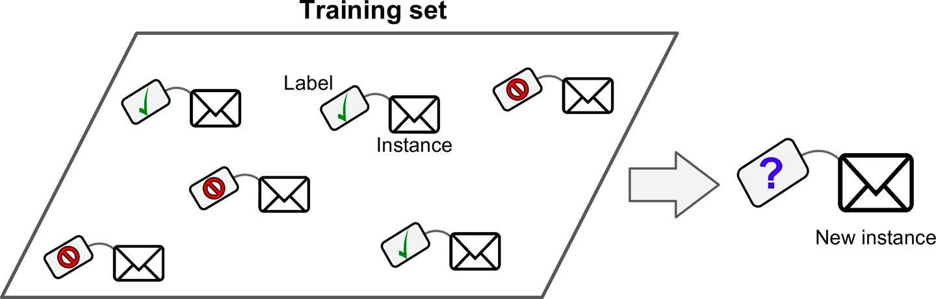
Machine Learning - Supervised Learning
Classification
Classify new email as Ham or Spam
Spam filter
Is trained with many example emails called training data.
Each email in the training data contains the label if it is spam or ham(not spam)
Models then learns to classify new emails if they are spam or ham

Slide 59
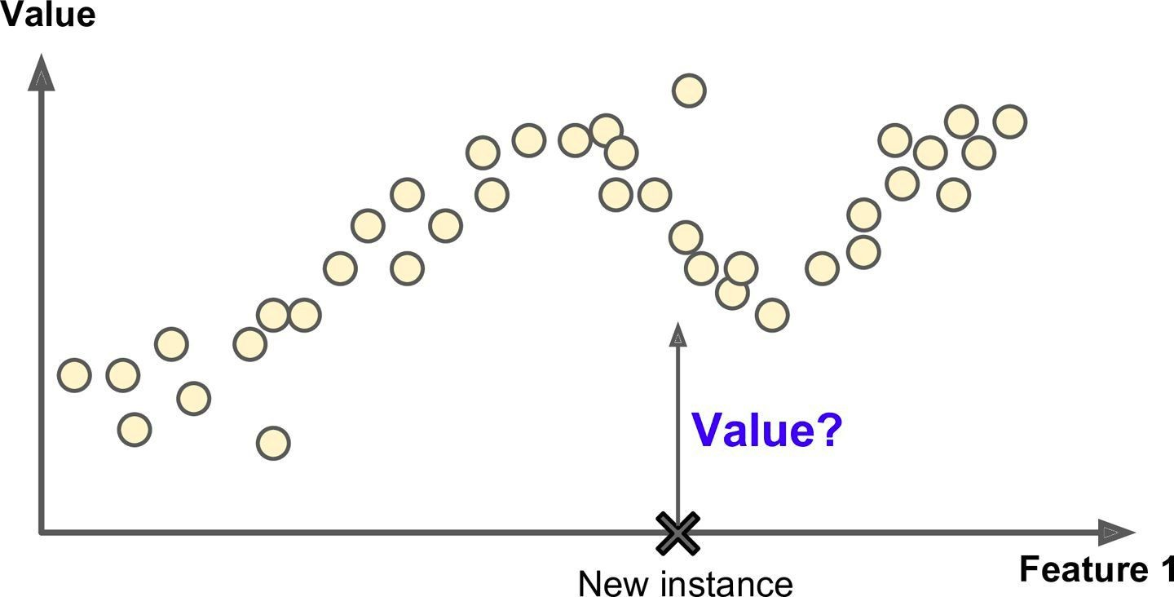
Machine Learning - Supervised Learning
Regression - Predict the price of the car (Value)

Slide 60
Machine Learning - Supervised Learning
Regression
Predict price of the car
Given a set of features called predictors such as
Mileage, age, brand etc
To train the model
We have to give many examples of cars
Including their predictors and labels(prices)

Slide 61
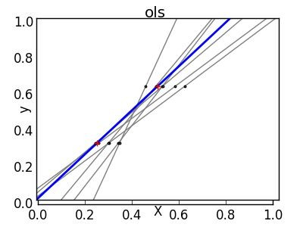
Machine Learning - Gradient Descent
Instead of trying all lines, go into the direction yielding better results

Slide 62

Machine Learning - Gradient Descent
Imagine yourself blindfolded on the mountainous terrain
And you have to find the best lowest point
If your last step went higher, you will go in opposite direction
Other, you will keep going just faster

Slide 63
Machine Learning - Types
Classification
Supervised
Regression
Unsupervised
Human Supervision?
Reinforcement
Machine Learning
Learn Incrementally?
How they generalize?

Slide 64
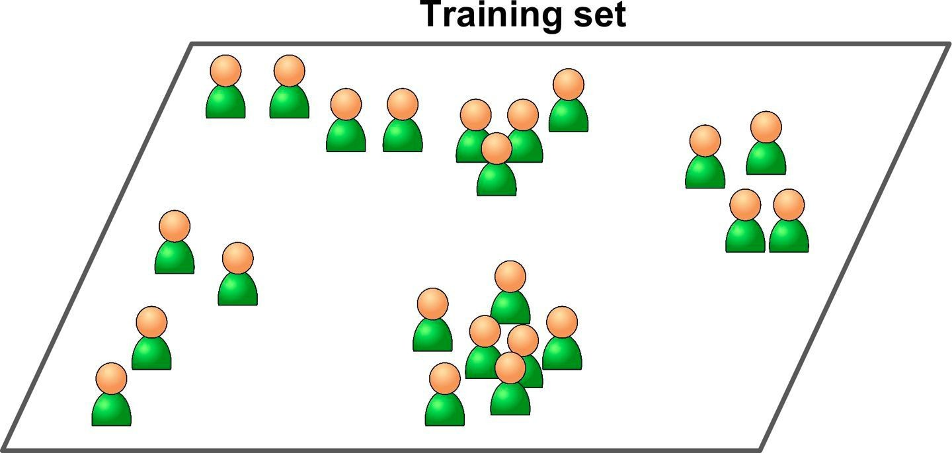
Machine Learning - Unsupervised Learning
The training data is unlabeled
The system tries to learn without a teacher

Slide 65

Machine Learning - Types
Classification
Supervised
Regression
Human Supervision?
Unsupervised
Clustering
Reinforcement
Machine Learning
Learn Incrementally?
How they generalize?

Slide 66
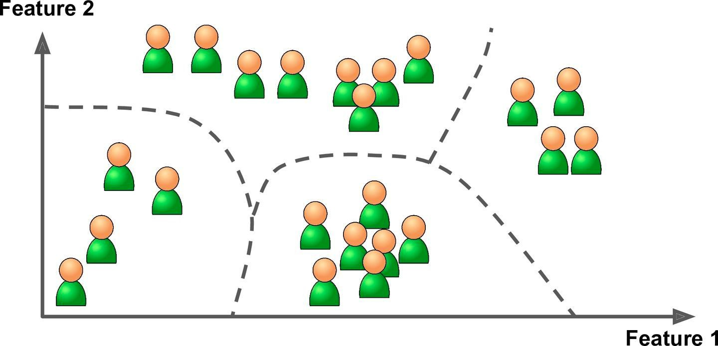
Machine Learning - Unsupervised Learning
Clustering - Detect group of similar visitors in your blog

Slide 67
Machine Learning - Unsupervised Learning
Clustering
Detect group of similar visitors in blog
Notice the training set is unlabeled
To train the model
We just feed the training set to clustering algorithm
At no point we tell the algorithm which group a visitor belongs to
It find groups without our help

Slide 68
Machine Learning - Unsupervised Learning
Clustering
It may notice that
40% visitors are comic lovers and read the blog in evening
20% visitors are sci-fi lovers and read the blog during weekends
This data helps us in targeting our blog posts for each group

Slide 69
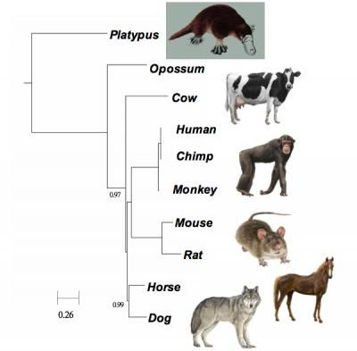
Machine Learning - Unsupervised Learning
Hierarchical Clustering - Bring similar elements together
In the form of a tree
Nodes closer to each other are similar

Slide 70
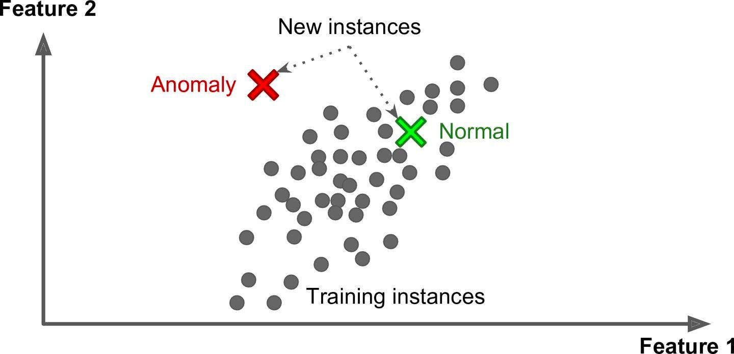
Machine Learning - Unsupervised Learning
Anomaly Detection - Detecting unusual credit card transactions to prevent fraud

Slide 71
Machine Learning - Types
Classification
Supervised
Regression
Human Supervision?
Unsupervised
Clustering
Reinforcement
Machine Learning
Learn Incrementally?
How they generalize?

Slide 72

Machine Learning - Reinforcement Learning

Slide 73
Machine Learning - Reinforcement Learning
The learning system an agent in this context
Observes the environment
Selects and performs actions and
Get rewards or penalties in return
Learns by itself what is the best strategy (policy) to get most reward over time

Slide 74
Machine Learning - Reinforcement Learning
Applications
Used by robots to learn how to walk
DeepMind’s AlphaGo
Which defeated world champion Lee Sedol at the game of Go

Slide 75


Machine Learning - Types
Classification
Supervised
Regression
Human Supervision?
Unsupervised
Clustering
Reinforcement
Machine Learning
Online
Learn Incrementally?
Batch Processing
How they generalize?

Slide 76
Machine Learning - Batch Learning

Slide 77
Machine Learning - Batch Learning
Offline learning
System is incapable of learning incrementally
It must be trained offline using all the available data
Takes lot of time and computing resources
everytime training happens on the entire data

Slide 78
Machine Learning - Batch Learning
Once the system is trained, it gets
Pushed to production
Runs without learning anymore
Just applies what it has learned offline

Slide 79
Machine Learning - Batch Learning
How to train the system with new data?
We can not train the system incrementally
We have to train the new system
From scratch on the full dataset
Stop the old system and
Replace it with the newly trained system

Slide 80
Machine Learning - Batch Learning
Limitations
Since we have to train new system every time new data is available
Takes lot of computing resources
If the data is huge then
Training from scratch is nearly impossible
Becomes showstopper for lot of practical use cases

Slide 81
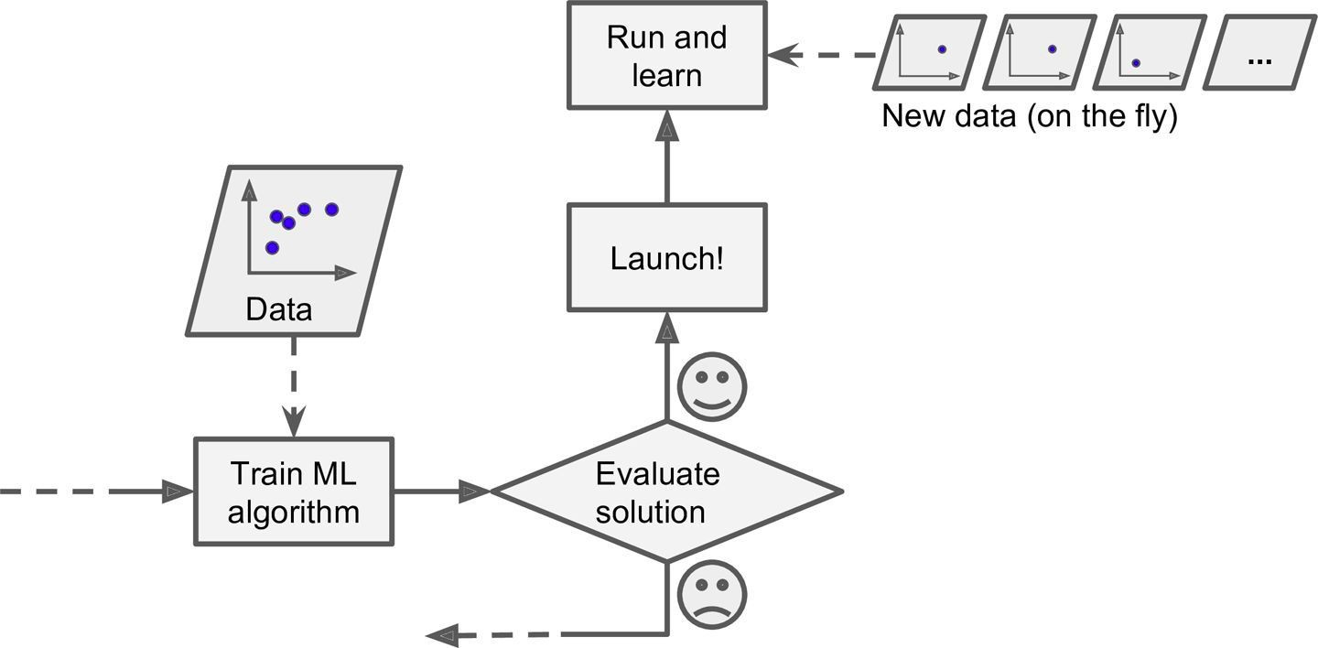
Machine Learning - Online Learning

Slide 82
Machine Learning - Online Learning
Train system incrementally
By feeding new data sequentially
Or in batches
System can learn from new data on the fly
Good for systems where data is a continuous flow
Stock prices

Slide 83
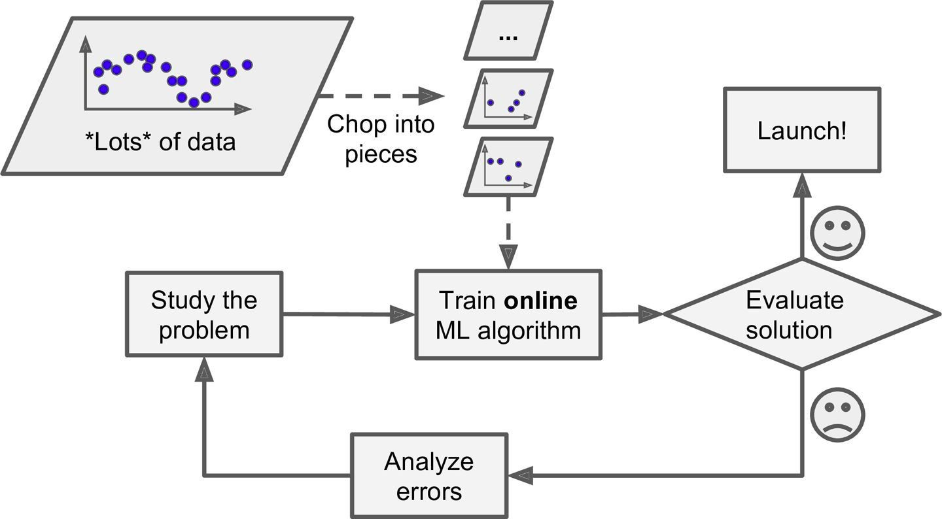
Machine Learning - Online Learning
Using online learning to handle huge datasets

Slide 84
Machine Learning - Online Learning
Using online learning to handle huge datasets
Can be used to train huge datasets
That can not be fit in one machine
The training data gets divided into batches and
System gets trained on each batch incrementally

Slide 85
Machine Learning - Online Learning
Challenges in online learning
System’s performance gradually declines
If bad data is fed to the system
Bad data can come from
Malfunctioning sensor or robot
Someone spamming your system

Slide 86
Machine Learning - Online Learning
Challenges in online learning
Closely monitor the system
Turn off the learning if there is a performance drop
Or monitor the input data and remove anomalies

Slide 87
Machine Learning - Instance & Model-Based Learning
Most Machine Learning tasks are about making predictions
Having a good performance in training data is good
But true goal is to perform well on new instances
System needs to be able to generalize to examples it has never seen before

Slide 88



Machine Learning - Types
Classification
Supervised
Regression
Human Supervision?
Unsupervised
Clustering
Reinforcement
Machine Learning
Online
Learn Incrementally?
Batch Processing
Instance Based
How they generalize?
Model based

Slide 89
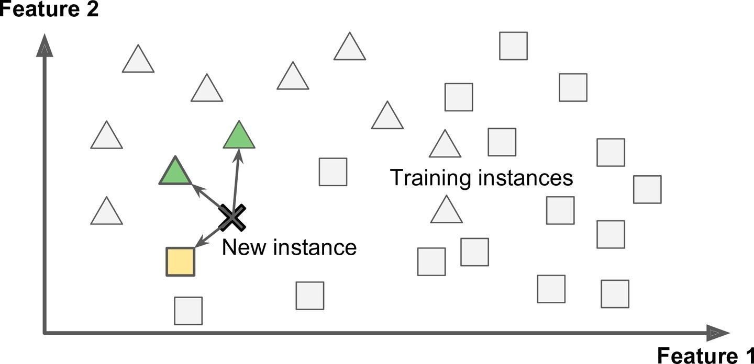
Machine Learning - Instance-based Learning

Slide 90
Machine Learning - Instance-Based Learning
Most trivial form of learning is
Learn by heart
The system learns the examples by heart
Then generalizes to new cases using a similarity measure

Slide 91
Machine Learning - Instance-Based Learning
Example
Spam filter flags emails
That are identical to known spam emails (emails marked spam by users)
Also the emails which are similar to known spam emails
This requires measure of similarity between two emails
A basic similarity measures between two emails can be
Count the number of words they have in common

Slide 92
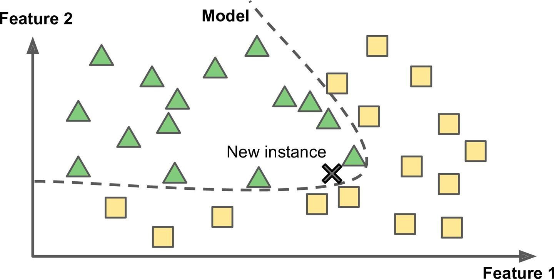
Machine Learning - Model-based Learning

Slide 93
Machine Learning - Model-Based Learning
Another way to generalize from a set of examples
Build a model of these examples
And then use model to make predictions
This is called inference
Hope that model will generalize well
We will learn more about it in next session

Slide 94
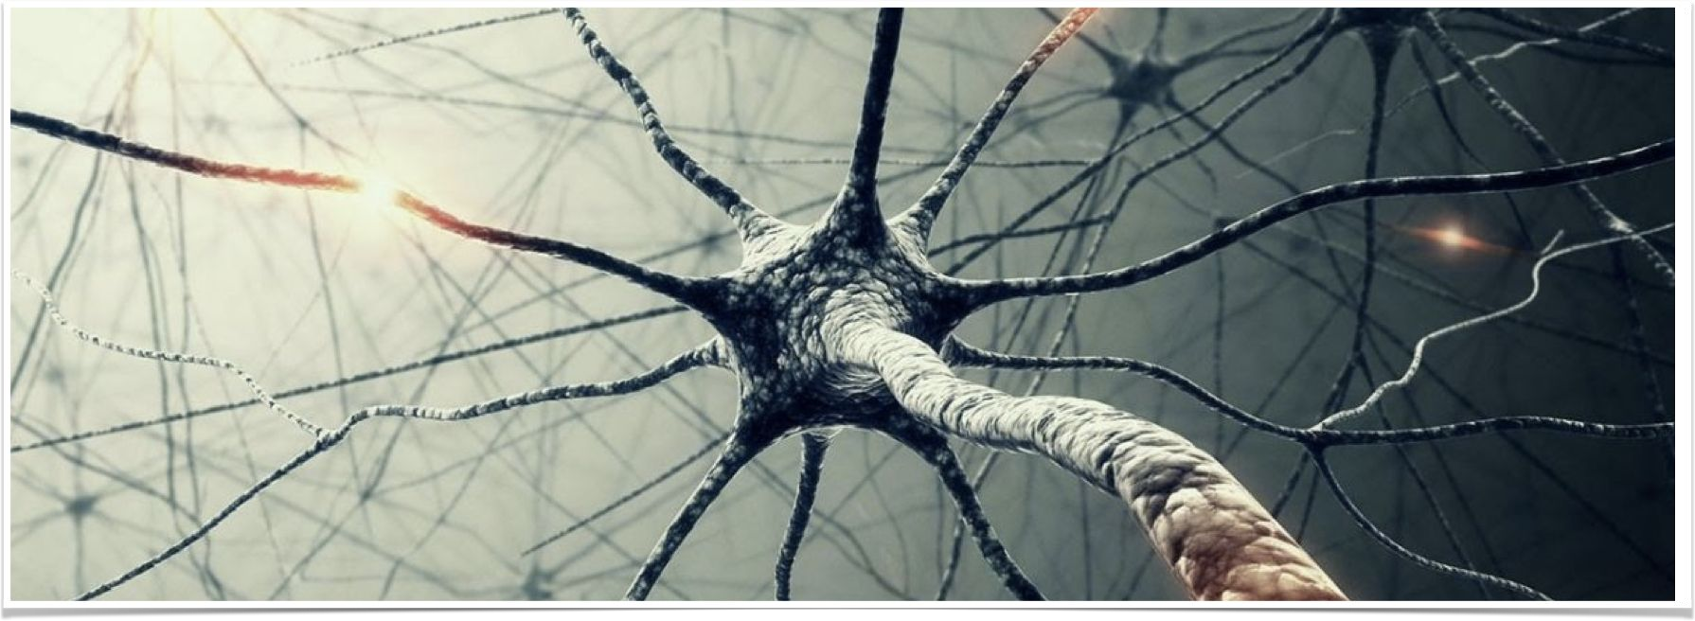
Machine Learning - Artificial Neural Network(ANN)
Computing systems inspired by the biological neural networks that constitute animal brains.

Slide 95
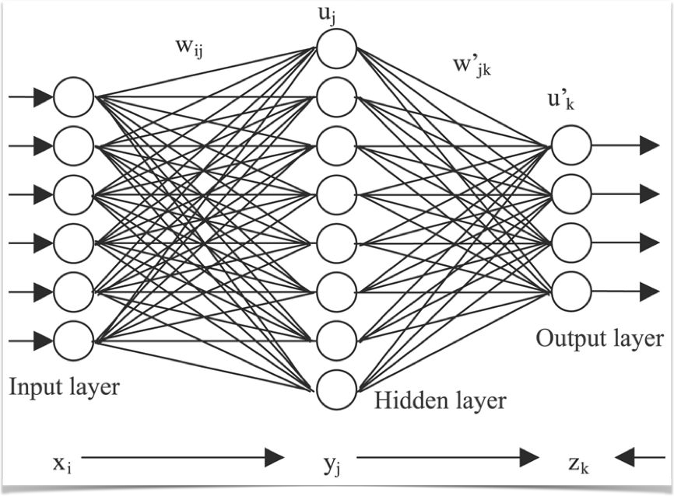
Machine Learning - Artificial Neural Network(ANN)
Learn (progressively improve performance)
To do tasks by considering examples
Generally without task-specific programming
Example: Based on image - cat or no cat?

Slide 96

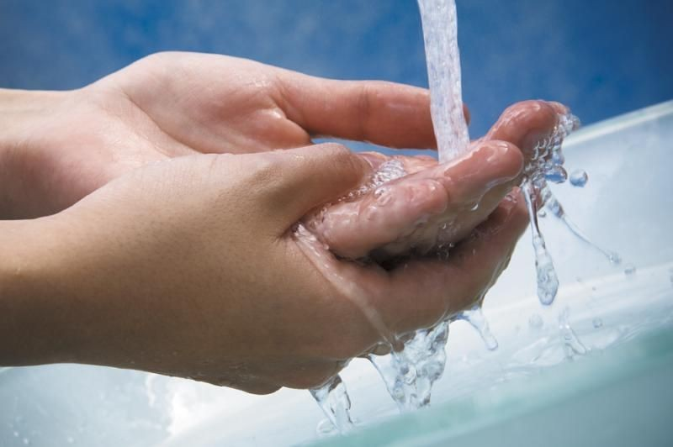
Machine Learning - Deep Learning
Hot Water
Cold Water
Each Neuron
Each Neuron is like the knob.

Slide 97
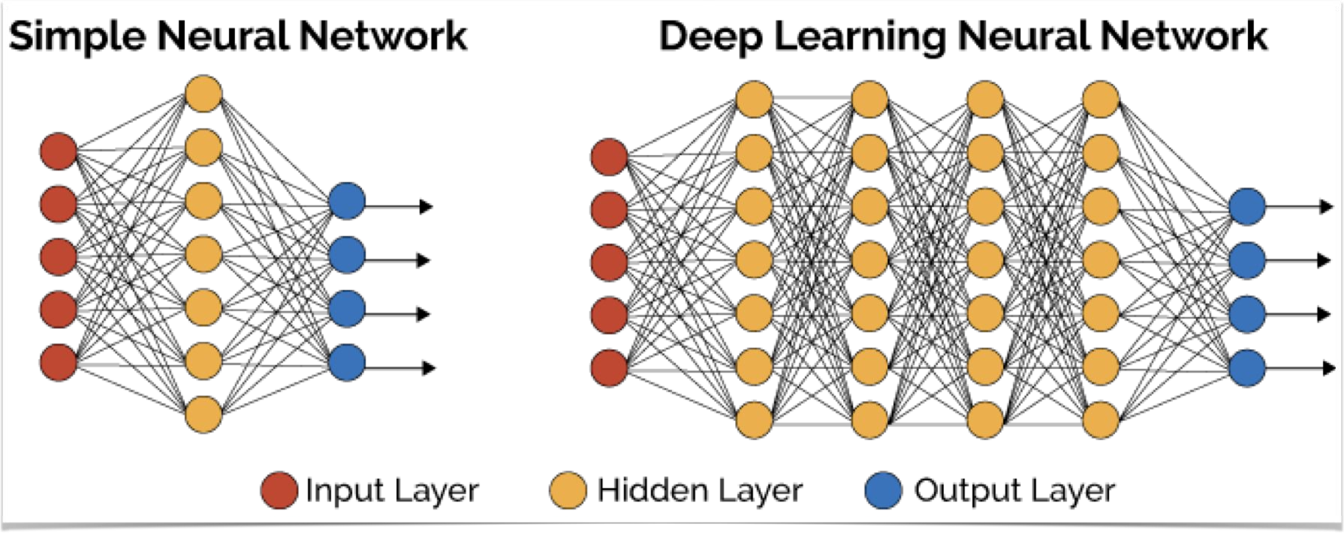
Machine Learning - Deep Learning
Multiple layers of neutrons

Slide 98
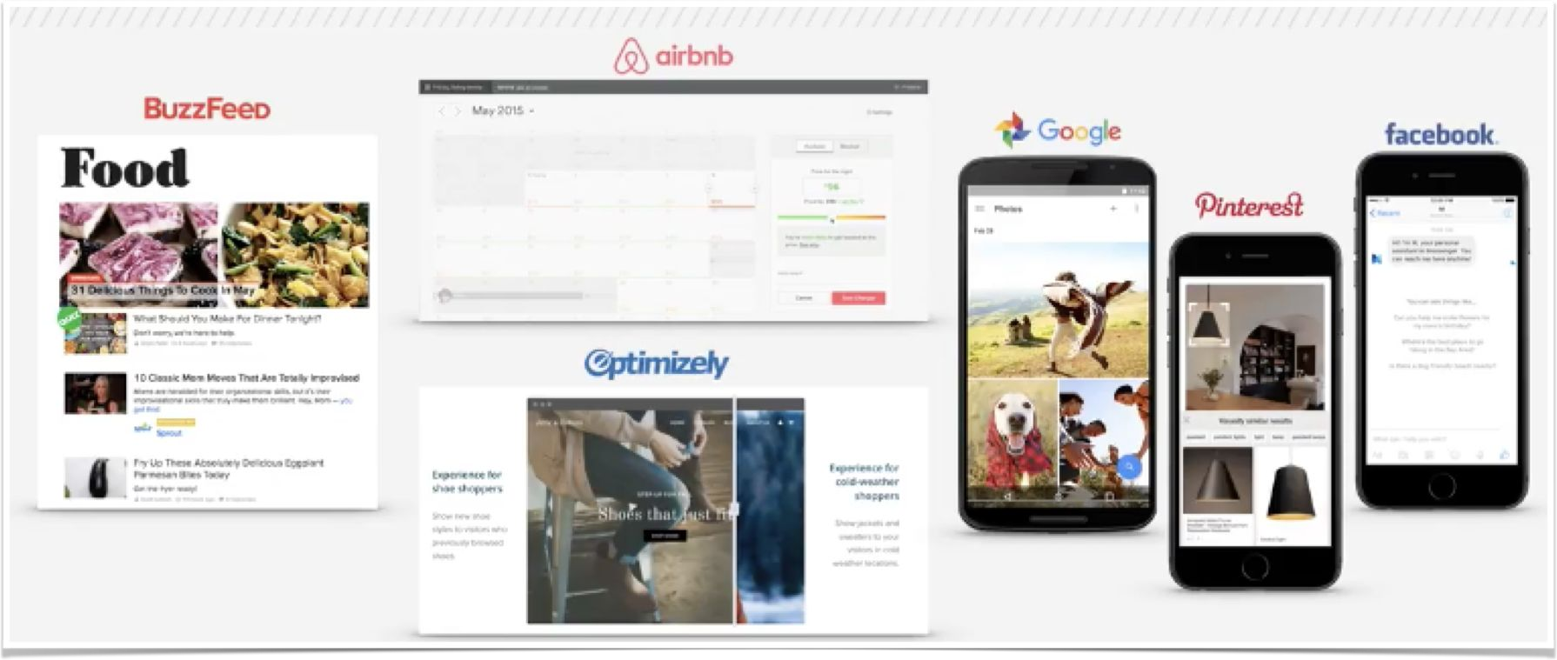
Machine Learning - Who is Using?
Almost Everyone

Slide 99
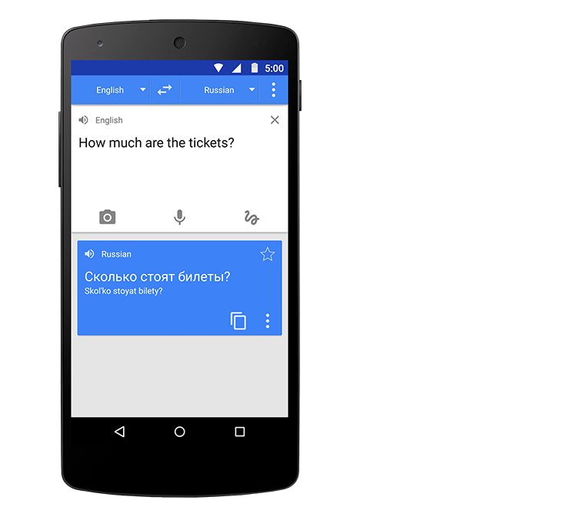
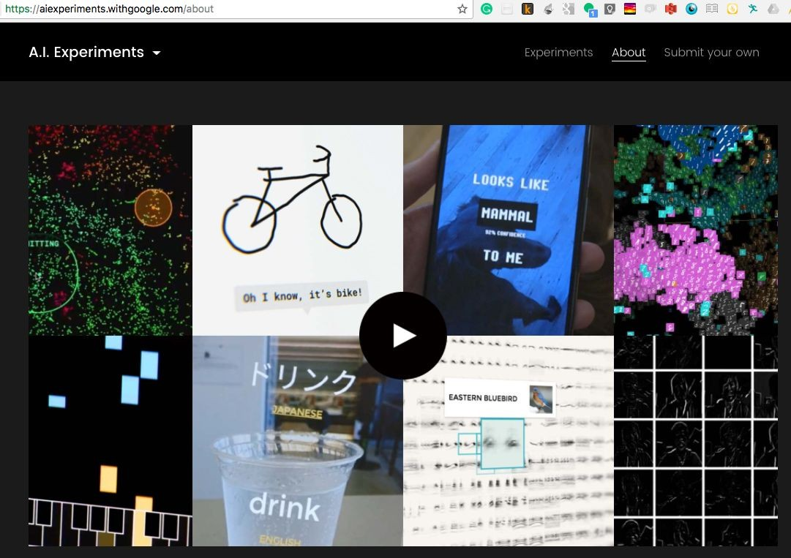
Google Translate & Auto Draw
More use cases: https://aiexperiments.withgoogle.com/

Slide 100
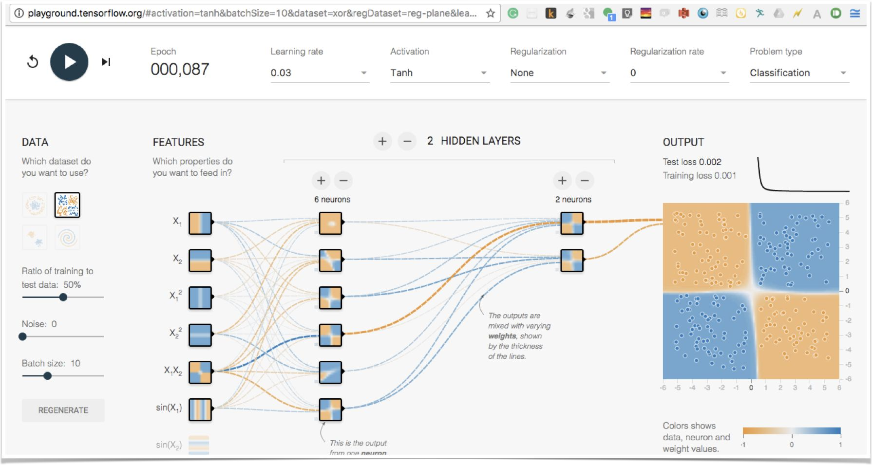
TensorFlow - Demo
http://playground.tensorflow.org/

